Slide 1

Help Your Child With Writing

Slide 2
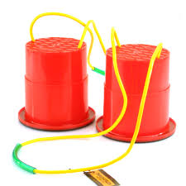
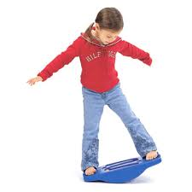
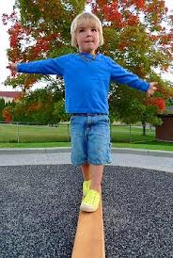
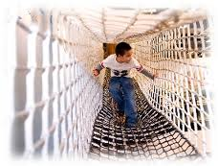
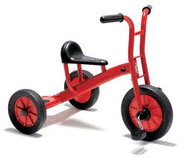
Motor Skills
Before children are expected to begin formal handwriting it is important that their gross and fine motor skills are firmly established.
Gross motor skills are a child’s ability to control the body. Children need to develop good posture and balance for handwriting. Children need to develop skills in co-odination, control, manipulation and movement.
At school we provide children with lots of opportunities to develop these skills through their play.

Slide 3
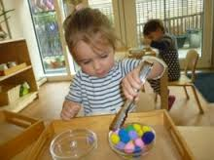
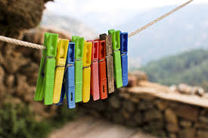
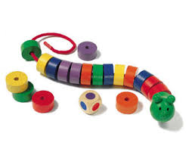
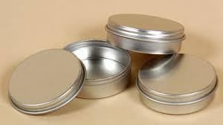
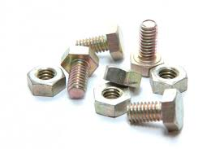
Fine motor skills are the ability to fine tune movements of the arm, hand and fingers. Until children have gained reasonable fine motor control through a range of small scale movements, handwriting will be a difficult skill to acquire.
Children develop fine motor control and co-ordination through a range of activities, such as threading beads, cutting and sticking or using tongs or tweezers to pick up small objects.

Slide 4
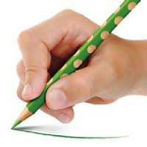
Letter Formation
At The Downley School children are taught to do cursive writing. However, in Reception this year we will be introducing the children to basic letter formation first. Cursive writing will be introduced when children are ready.
As we teach each letter, we will model how to form the letters correctly using pictures as a guide e.g. when writing the letter s, children will follow the shape of the snake.
Handwriting skills develop over a period of time and a child’s ability to write is a separate skill from Phonics.
When children begin using a pencil and writing, it is important that they hold the pencil correctly using the pincer grip – in school we call this using our Freddie Frog fingers!

Slide 5
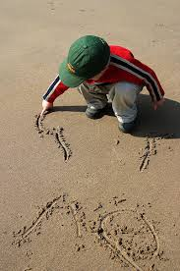
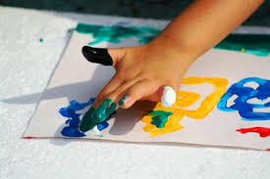
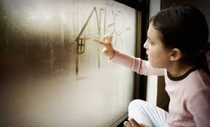
Mark Making
Children should be encouraged to make marks. Their early marks show that they are beginning to understand the writing process. When their marks begin to contain letters, this shows that they are aware that writing needs real letters.
Encourage your child to make marks in a variety of ways. Early writing does not always have to be with a pencil and paper. It could be with their finger in the sand, using sticks to write in the mud or painting. Children’s writing develops over time. Allow them time to practise and give them lots of praise for their efforts!

Slide 6
How adults can help
Be a model and make sure that your child sees you writing. They will begin to understand that writing has a purpose and that it is useful. Model left to write orientation and top to bottom sequencing.
Write together in a variety of ways. For example, writing an email to invite a friend to tea, writing cards and invitations or writing a shopping list together. Make sure that writing has a purpose.
Take every opportunity to ‘read back’ writing.
When you write with your child think aloud so that they can hear the decisions you’re making as you write.
Provide your child with a special writing box full of things to write with, such as pens, pencils of different thickness, coloured pens, high lighters and gel pens. Provide cards and envelopes, sticky tape to make little books, coloured paper and a large canvas, such as rolls of wall paper.
Praise children for their play writing. The early squiggles and marks show that your child is beginning to understand writing.

