Slide 1
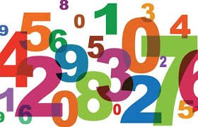
Number

Slide 2
Maths in the EYFS is split into two areas: Number and Shape, Space and Measure.
Number involves children being able to count, recognise and order numbers and use their number skills within practical activities.
By the end of Reception most children will be able to:
Count reliably with numbers to 20, place them in order and say which number is one more or one less than a given number.
Use quantities of objects to add and subtract two single digit numbers, counting on or back to find the answer.
Solve problems involving doubling, halving and sharing.

Slide 3
Maths in Reception is taught in a very practical and purposeful way. Children will use play and exploration to help them to acquire mathematical skills. Maths work is very practical and learning will happen in many different contexts both inside and in the outdoor area.
Some class work exploring mathematical concepts will be adult-led and children can also freely explore these concepts through a variety of different activities set up in the indoor and outdoor classrooms.
You can help at home by making the most of opportunities to explore number and counting within the everyday activities you do with your child. Here are some examples:

Slide 4
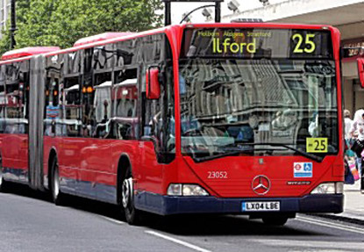
In the street
Recognising bus numbers
Number plate hunt. Who can find a 7? Add the numbers up.
Comparing door numbers. Looking for any patterns they can see e.g. the door numbers on one side of the road counting up in twos.
Counting – how many lamp posts on the way to school?

Slide 5
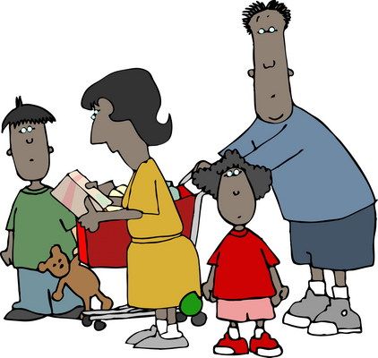
Going shopping
Reading price tags
Counting items into the basket
Finding and counting coins
Count things that come in sets e.g. 4 bread rolls, 6 eggs, 3 bars of soap. Add sets together e.g. 2 packs of 4 bread rolls makes 8.

Slide 6
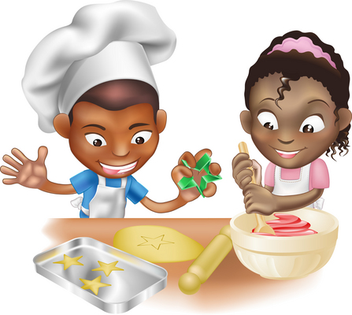
Dinner Time
Can you cut your toast into 4 pieces?
Get you child to help you to set the table. Count the right number of plates etc. How many more do we need?
Helping with the cooking by measuring and counting ingredients needed.

Slide 7
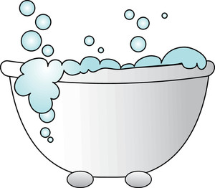
Bath/Bed Time
Play with number toys in the bath.
Practise writing numbers on steamed up shower glass.
How many counts does it take for the water to go down the plug hole?
Count how many stairs up to bed.
Count how many books in a pile. When you have read one count how many are left.

Slide 8
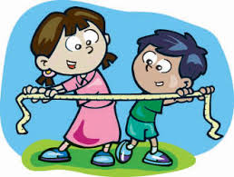
Shape, Space and Measure

Slide 9
Shape, Space and Measure involves children being able to use mathematical language correctly within their play and to be able to make comparisons.
By the end of Reception most children will be able to:
Use everyday language to talk about size, shape, position, distance, time and money.
Compare quantities and objects and solve simple practical problems.
Recognise, create and describe patterns.
Explore characteristics of everyday objects and shapes and use mathematical language to describe them.
Here are some examples of ways you can explore shape, space and measures at home with you child.

Slide 10
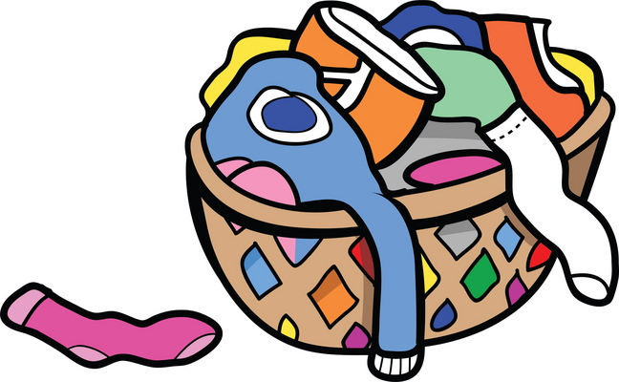
Doing the washing
Counting in 2s – matching shoes
Sorting by colour and size.
Matching/pairing up socks.
Find four shoes that are different sizes. Can you put them in order.

Slide 11
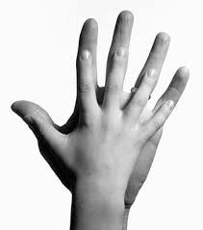
Measuring
Compare the sizes of family members. Who is the tallest? Who is the shortest?
Marking height on the wall.
Cut hand shapes out of paper. How many hands long is the couch? How long is the table? Which is longer?
Who has the biggest hands in our family?
How many steps from the gate to the front door?

Slide 12
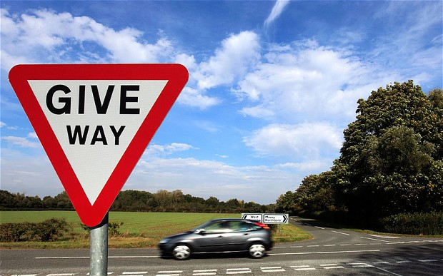
Shapes
Cut a potato into shapes (circles, triangle etc). Use with paint to make pictures and patterns.
Cut out shapes from coloured paper and arrange into pictures.
Shape hunt: Can you find a square in your house (e.g. windows), a circle etc…
Notice shapes as you are out and about e.g. how many different shapes can you find at the park?
Look for 3D shapes in the supermarket. Can you find a cylinder (e.g. a can of baked beans), a cube etc…

Slide 13
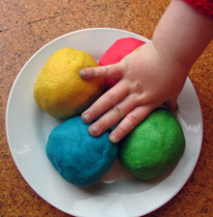
Make Playdough
Here’s a simple recipe:
1 cup of plain flour
1 cup of water
1 tablespoon cooking oil
2 teaspoons cream of tartar
Half a cup of salt
food colouring and essences (optional)
Put all ingredients in a large saucepan, and heat slowly, stirring all the time until it forms a ball. Keep it wrapped in clingfilm or in a covered tub to stop it drying out.

Slide 14
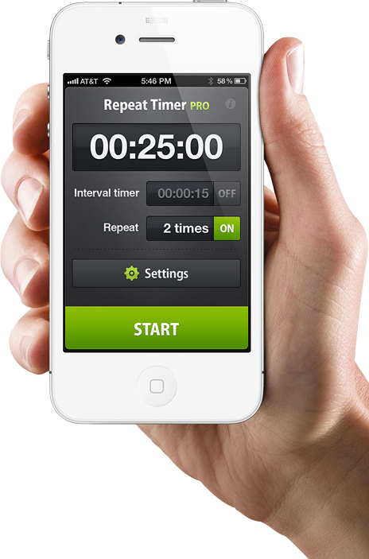
Time
Talk about the days of the week. What day is it today, tomorrow? Talk about things that you do on particular days of the week.
Use timers, phones and clocks to measure short periods of time e.g. set the timer to clean your teeth.
Count down 10/ 20 seconds to get to the table/ into bed etc.
Use language related to time e.g. morning, afternoon, night time.

